Slide 1
Tunnelling Association of Canada
Date
Equity, Diversity, and Inclusion Moment
Microaggressions
date

Slide 2
Tunnelling Association of Canada
What is a microaggression?
A comment or action that subtly and often unconsciously or unintentionally expresses a prejudiced attitude toward a member of a marginalized group (Merriam-Webster).
2

Slide 3
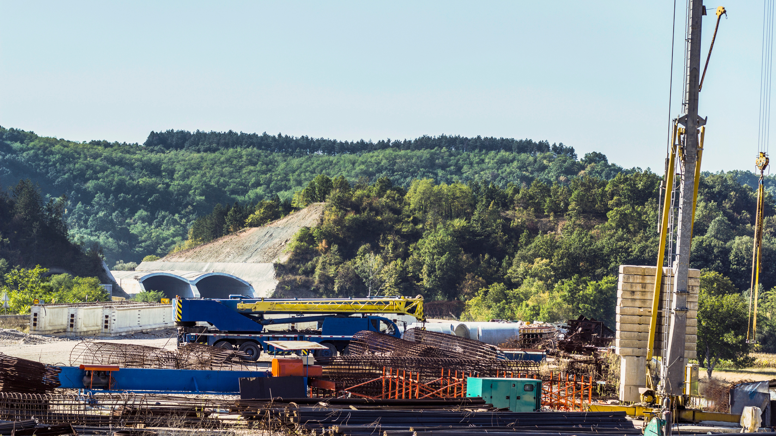
Tunnelling Association of Canada
Example
You notice someone is repeatedly interrupted in a meeting…
Discuss the following prompts:
What is your first reaction?
How could you react?
How could you intervene?
Could intervening be upsetting?
Would the other person want you to intervene, or want to handle the situation themselves?
If uncertain, you may wish to ask them after so that you know how to react in the future.
In what ways can the identities you hold (e.g., gender, race, position of influence, etc.) influence your decision to intervene?
3

Slide 4
Tunnelling Association of Canada
Date
Thank you!
The End

